Slide 1

Motion Decomposition in Video Generation
Presented by Sunqi Fan

Slide 2
inflate
diffusion
2D
3D
decompose
Motion
add
3D Video
Temporal layer
Content
Tune-A-Video
AnimateDiff
DSDN
LFDM
LaMD
PVDM
DSDN

Slide 3
Outline
MoCoGAN Mocogan: Decomposing motion and content for video generation
LaMD LaMD: Latent Motion Diffusion for Video Generation
PVDM Video probabilistic diffusion models in projected latent space
DSDN Dual-Stream Diffusion Net for Text-to-Video Generation

Slide 4
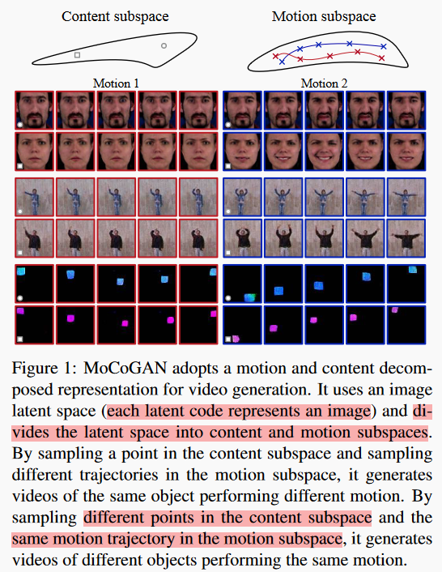
MoCoGAN
Tulyakov, S., Liu, M. Y., Yang, X., & Kautz, J. (2018). Mocogan: Decomposing motion and content for video generation. In Proceedings of the IEEE conference on computer vision and pattern recognition (pp. 1526-1535).

Slide 5

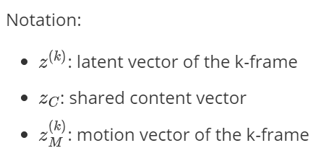
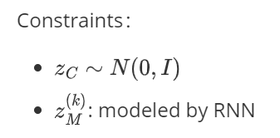
MoCoGAN
The compressed latent representation in MoCoGAN:
Tulyakov, S., Liu, M. Y., Yang, X., & Kautz, J. (2018). Mocogan: Decomposing motion and content for video generation. In Proceedings of the IEEE conference on computer vision and pattern recognition (pp. 1526-1535).

Slide 6
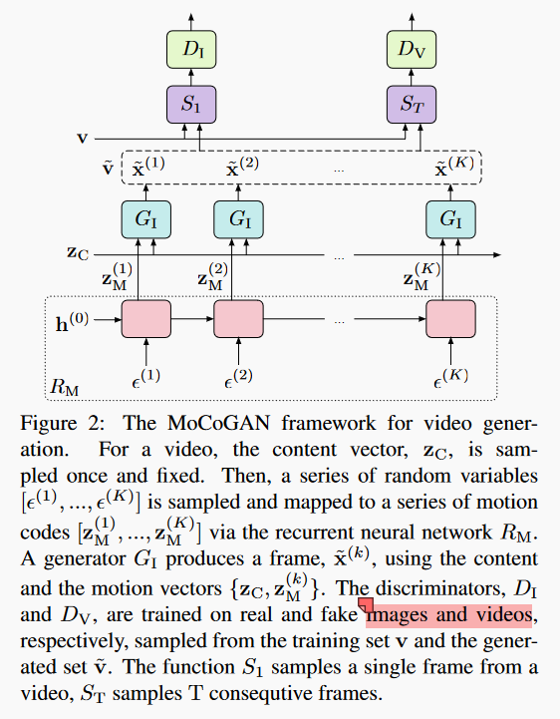
MoCoGAN
Tulyakov, S., Liu, M. Y., Yang, X., & Kautz, J. (2018). Mocogan: Decomposing motion and content for video generation. In Proceedings of the IEEE conference on computer vision and pattern recognition (pp. 1526-1535).
Notes:
RNN的作用是保证轨迹的合理性

Slide 7
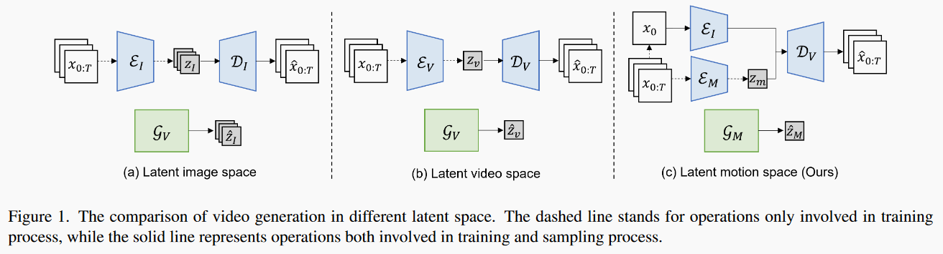
LaMD
Hu, Y., Chen, Z., & Luo, C. (2023). LaMD: Latent Motion Diffusion for Video Generation. arXiv preprint arXiv:2304.11603.

Slide 8
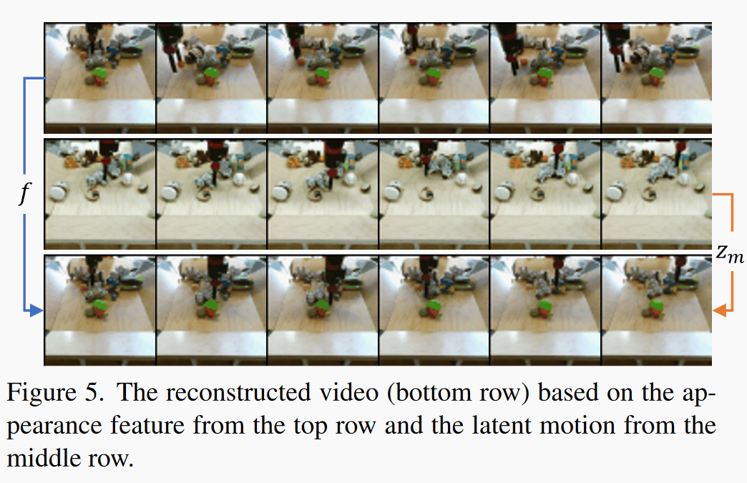
LaMD
Hu, Y., Chen, Z., & Luo, C. (2023). LaMD: Latent Motion Diffusion for Video Generation. arXiv preprint arXiv:2304.11603.

Slide 9
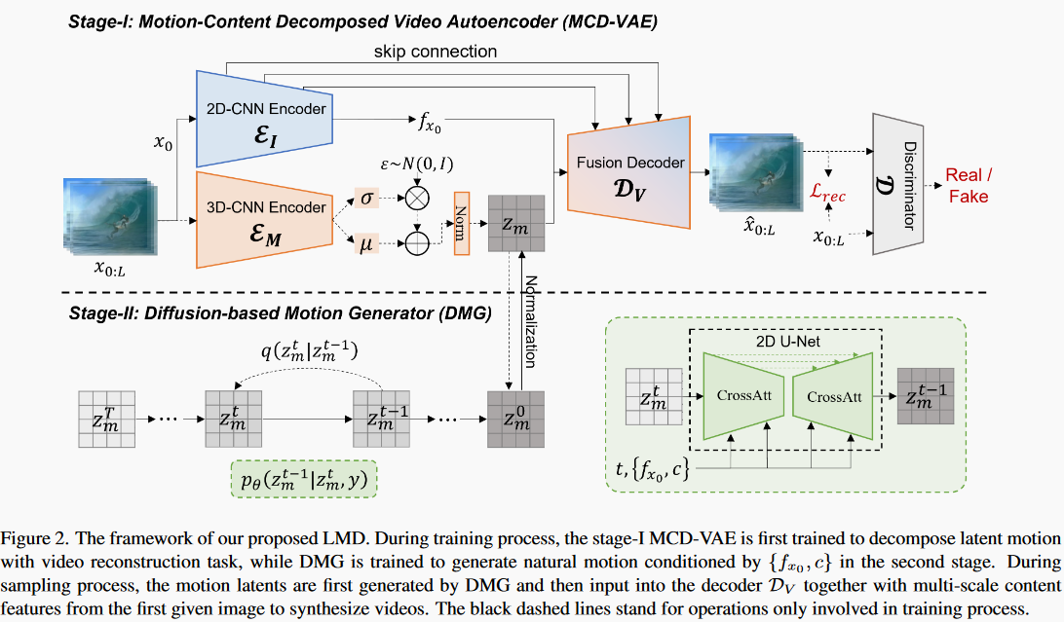
LaMD
Hu, Y., Chen, Z., & Luo, C. (2023). LaMD: Latent Motion Diffusion for Video Generation. arXiv preprint arXiv:2304.11603.

Slide 10
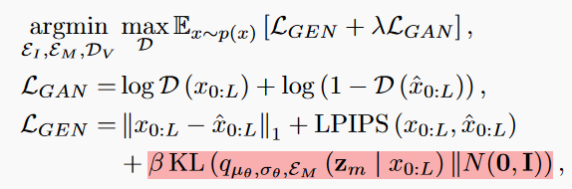
LaMD
training objective:
improve the realism of reconstructions
reconstruction loss
control a clean decomposition of motion latent
Hu, Y., Chen, Z., & Luo, C. (2023). LaMD: Latent Motion Diffusion for Video Generation. arXiv preprint arXiv:2304.11603.

Slide 11
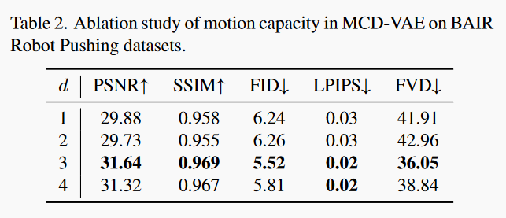
LaMD
ablation study on the channels of motion latent:
MCD-VAE can achieve high reconstruction performance even with a small channel size.
There is significant redundancy in motion.
video compression through motion decomposition and compression holds great potential.
Hu, Y., Chen, Z., & Luo, C. (2023). LaMD: Latent Motion Diffusion for Video Generation. arXiv preprint arXiv:2304.11603.

Slide 12
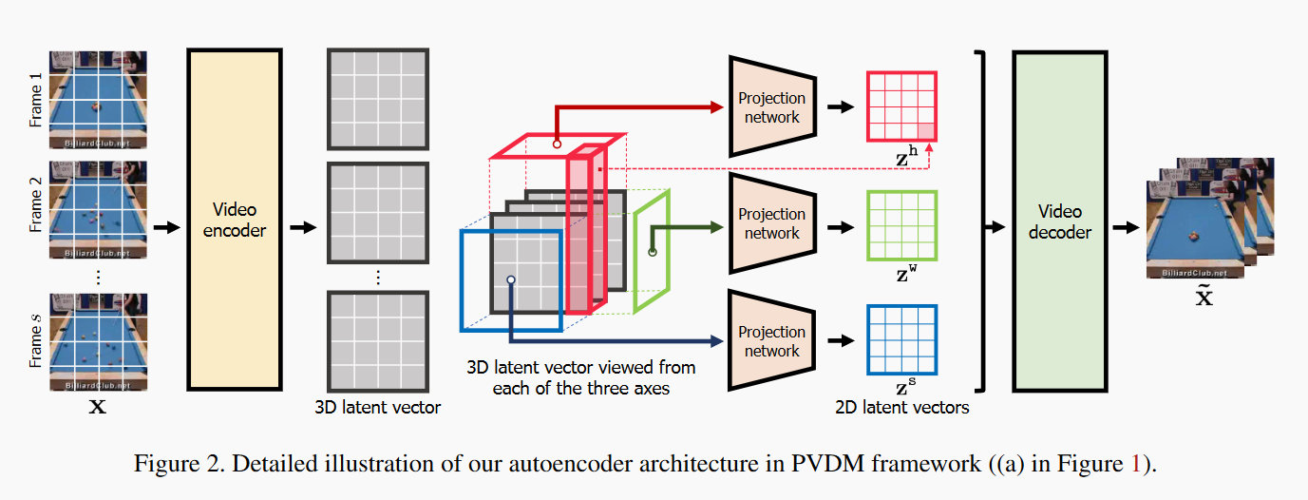
PVDM
Yu, S., Sohn, K., Kim, S., & Shin, J. (2023). Video probabilistic diffusion models in projected latent space. In Proceedings of the IEEE/CVF Conference on Computer Vision and Pattern Recognition (pp. 18456-18466).

Slide 13
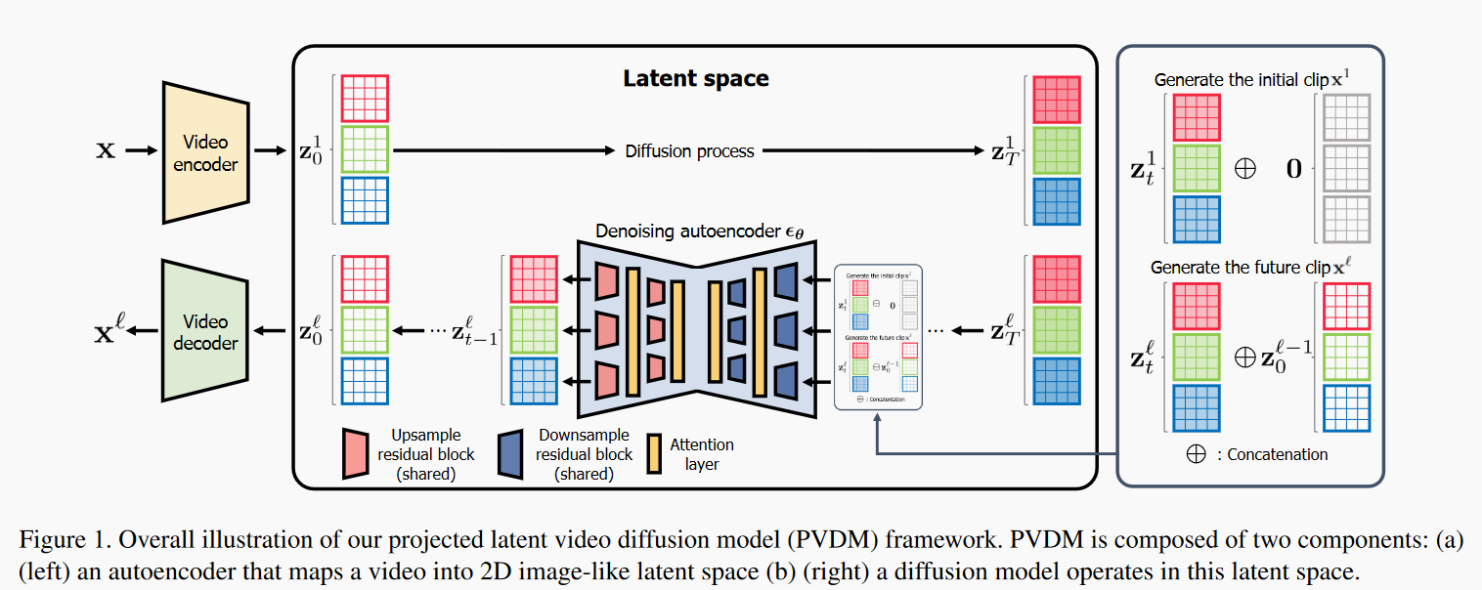
PVDM
Yu, S., Sohn, K., Kim, S., & Shin, J. (2023). Video probabilistic diffusion models in projected latent space. In Proceedings of the IEEE/CVF Conference on Computer Vision and Pattern Recognition (pp. 18456-18466).

Slide 14
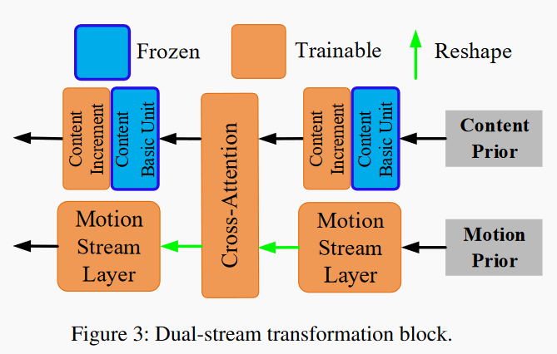
DSDN
Motion Decomposition + Temporal Layer
Liu, B., Liu, X., Dai, A., Zeng, Z., Cui, Z., & Yang, J. (2023). Dual-Stream Diffusion Net for Text-to-Video Generation. arXiv preprint arXiv:2308.08316.

Slide 15
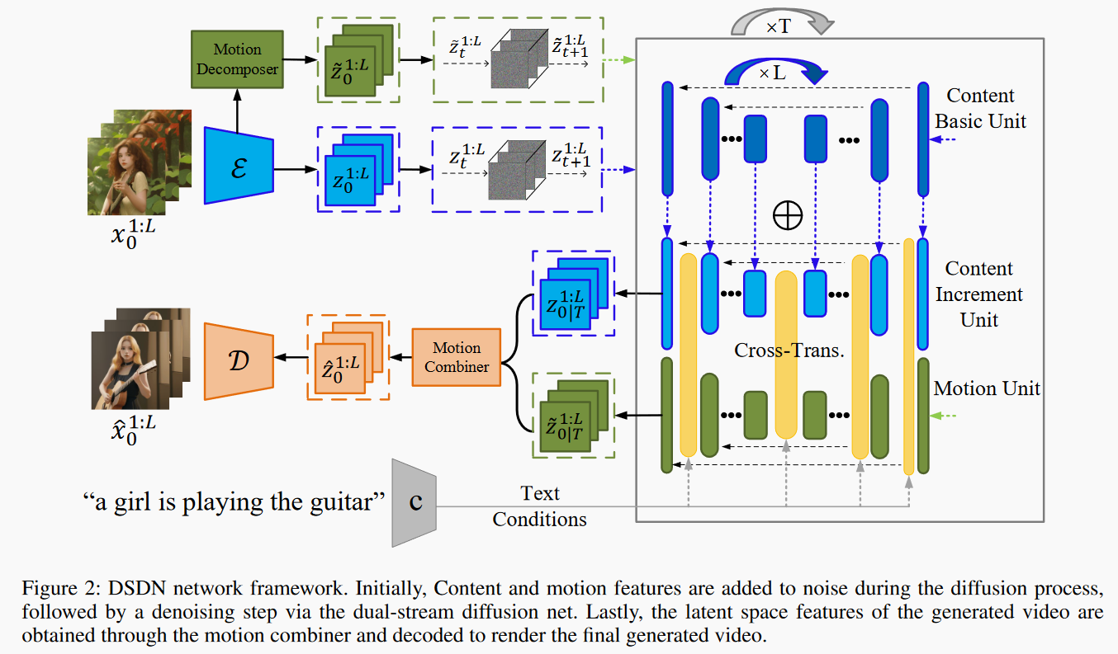
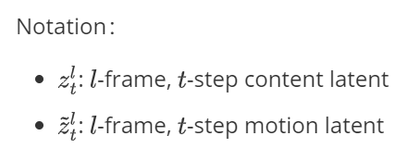
DSDN
Liu, B., Liu, X., Dai, A., Zeng, Z., Cui, Z., & Yang, J. (2023). Dual-Stream Diffusion Net for Text-to-Video Generation. arXiv preprint arXiv:2308.08316.

Slide 16
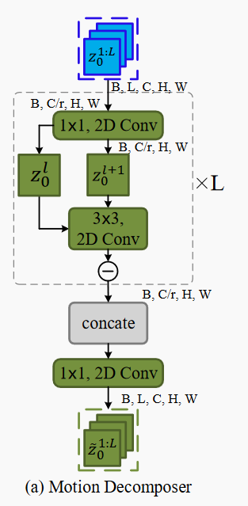

DSDN：Motion Decomposer
reduce the channel, reduce the computation cost
restore the channel
Liu, B., Liu, X., Dai, A., Zeng, Z., Cui, Z., & Yang, J. (2023). Dual-Stream Diffusion Net for Text-to-Video Generation. arXiv preprint arXiv:2308.08316.

Slide 17
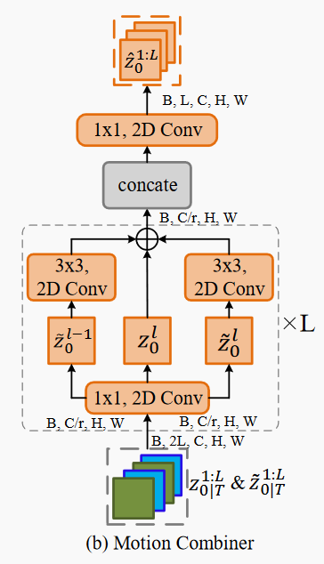

DSDN：Motion Combiner
restore the channel
reduce the channel, reduce the computation cost
Liu, B., Liu, X., Dai, A., Zeng, Z., Cui, Z., & Yang, J. (2023). Dual-Stream Diffusion Net for Text-to-Video Generation. arXiv preprint arXiv:2308.08316.

Slide 18
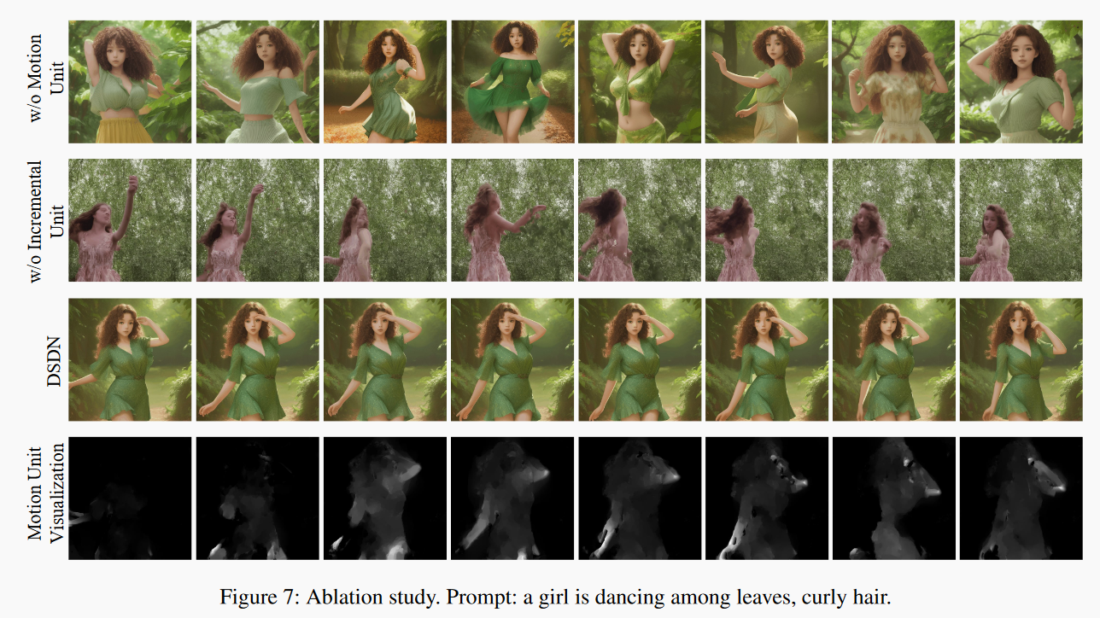
DSDN：Results
Liu, B., Liu, X., Dai, A., Zeng, Z., Cui, Z., & Yang, J. (2023). Dual-Stream Diffusion Net for Text-to-Video Generation. arXiv preprint arXiv:2308.08316.

Slide 19
Outline
MoCoGAN Mocogan: Decomposing motion and content for video generation
LaMD LaMD: Latent Motion Diffusion for Video Generation
PVDM Video probabilistic diffusion models in projected latent space
DSDN Dual-Stream Diffusion Net for Text-to-Video Generation

